Slide 1
Database Management System
Lecture # 5-6

Slide 2
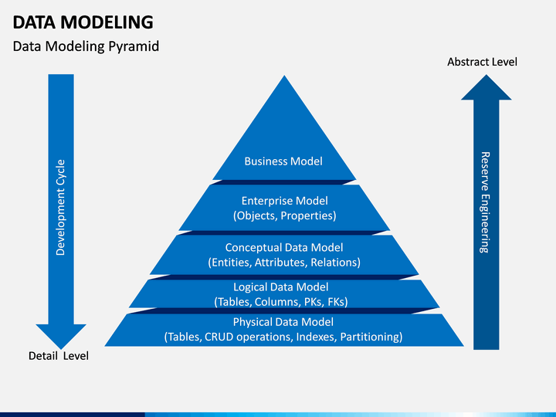
BM: company's plan for making a profit
CRUD (create, read, update and delete)
Notes:
The term business model refers to a company's plan for making a profit. It identifies the products or services the business plans to sell, its identified target market, and any anticipated expenses. Business models are important for both new and established businesses. They help new, developing companies attract investment, recruit talent, and motivate management and staff. Established businesses should regularly update their business plans or they'll fail to anticipate trends and challenges ahead. Business plans help investors evaluate companies that interest them.
Enterprise data modeling (EDM) is the practice of creating a graphical model of the data used by an enterprise or company. Typical outputs of this activity include​include an Enterprise Data Model consisting of entity–relationship diagrams (ERDs), XML Schemas (XSD), and an enterprise wide data dictionary.

Slide 3
Commonly used data models for databases
The most common logical data models for database are
Hierarchical Model
Network Model
Relational Model (Most Popular)
Entity–Relationship Model
Object-Oriented Models
Enhanced Entity Relationship Models
etc
Notes:
Physical data models include:
Inverted index
Flat file

Slide 4
1. Hierarchical Model
Developed by IBM, is the Oldest database model.
Represented using a tree-diagram. (Parent-child relationship)
Each box is called a „Node‟
Director
Manager (HR)
Manager (Sales)
Manager (Market.)
The nodes represent a record type.
Area Manager 1
Area Manager 2
Area Manager 3
A line connecting nodes represents
the link.
Sales Exe.
1
Sales Exe.
2
Sales Representative

Slide 5
1. Hierarchical Model
Parent-child type is suited for One-to-many
relationship between two entities.
Director
But difficult to implement many-to-many relationship. e.g.:
IMS system from IBM.
Manager
(HR)
Manager
(Sales)
Manager
(Market.)
Area
Manager 1
Area
Manager 2
Area
Manager 3
Sales Exe.
1
Sales Exe.
2
Sales
Representative

Slide 6
2. Network Model
Represented using a Data-Structure Diagram.
Boxes represents the records & lines the links.
Based on
„owner-member relationship.‟
Members of an owner may
be many but for many membe owner is one.
Can represent one-to-one and many-to-many as well.
Teacher 1
Teacher 2
Teacher 3
rs
Course A
Course B
Course C
Student 1
Student 2
Student 3

Slide 7
2. Network Model
One-to-many relationship is converted into a set of one-to-one.
Also, many-to-many is converted into 2 or more one-to-many relationship.
e.g.:
IDMS, IMAGE.
Teacher 1
Teacher 2
Teacher 3
Course A
Course B
Course C
Student 1
Student 2
Student 3

Slide 8
3. Relational Model
Simplest and the most common model.
Developed in 1970 by E.F. Codd, it became commercial in the 80s.
Data elements are stored in different tables made up of rows and columns.
Roll No | Name | Surname | Section
1001 | Ahmad | Muhammad | D
1002 | Ali | Muhammad | D

Slide 9
3. Relational Model
Terminologies:
-Data Values: alphanumeric raw data
-Columns: fields (item or object that holds the data)
-Rows: record (a group of data for related field)
-Table: collection (all records & fields)
-Key: identifier (uniquely identifies a row in the table. It can be value of a single or multiple column. e.g.:
DB2, ORACLE, SQL Server.
Roll No | Name | Surname | Section
1001 | Ahmad | Muhammad | D
1002 | Ali | Muhammad | D

Slide 10
4. Entity–Relationship Model
Entity Relationship Model (ER Modeling) is a graphical approach to database design.
It is a high-level data model that defines data elements and their relationship.
An ER model is used to represent real-world objects.
An Entity is a thing or object in real world that is distinguishable from surrounding environment. For example, each employee of an organization is a separate entity. An entity has a set of properties & Entity properties can have values

Slide 11
4. Entity–Relationship Model
College |  | Principal
College 1
Course A
Student A
College 2
Course B
College
Student B
College 3
Course C
Student C
Relationships E-R diagram
Stud_Name
Stud_Roll No
Course_Id
Course_Name
Student
Admission
Course

Slide 12
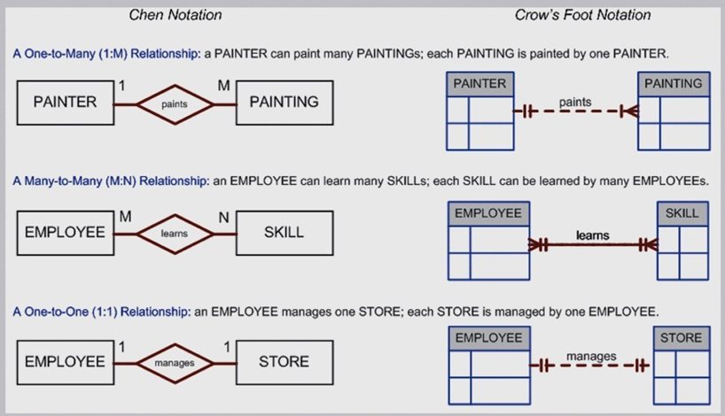
Chen & Crow’s Foot Notations
4. Entity–Relationship Model

Slide 13
5. Object-Oriented Models
Object oriented data model is designed using the entities in the real world, attributes of each entity and their relationship.
Object oriented data model is based upon real world situations. These situations are represented as objects, with different attributes. All these object have multiple relationships between them.
It picks up each thing/object in the real world which is involved in the requirement.

Slide 14
5. Object-Oriented Models
Elements of Object oriented data model
Objects
The real world entities and situations are represented as objects in the Object oriented database model.
Attributes and Method
Every object has certain characteristics. These are represented using Attributes. The behaviour of the objects is represented using Methods.

Slide 15
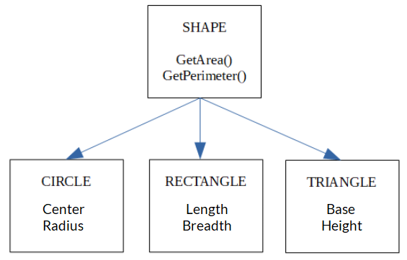
5. Object-Oriented Models: Example
Shape, Circle, Rectangle and Triangle are all objects in this model.
Circle has the attributes Center and Radius.
Rectangle has the attributes Length and Breath
Triangle has the attributes Base and Height.
The objects Circle, Rectangle and Triangle inherit from the object Shape.

Slide 16
5. Object-Oriented Models
Elements of Object oriented data model
Class
Similar attributes and methods are grouped together using a class. An object can be called as an instance of the class.
Inheritance
A new class can be derived from the original class. The derived class contains attributes and methods of the original class as well as its own.

Slide 17
6. Enhanced Entity Relationship (EER) Model
Enhanced Entity Relationship (EER) Model is a high-level data model which provides extensions to original Entity Relationship (ER) model.
EER Models supports more details design. EER Modeling emerged as a solution for modeling highly complex databases.
EER uses UML notation. UML is the acronym for Unified Modeling Language; it is a general-purpose modeling language used when designing object-oriented systems. Entities are represented as class diagrams. Relationships are represented as associations between entities.

Slide 18
6. Enhanced Entity Relationship (EER) Model
Following are the basic UML building blocks
Things
A thing can be described as any real-world entity or an object
Relationships
The relationship allows you to show on a model how two or more things relate to each other.
Diagrams
UML diagrams are divided into three different categories such as Structural diagram, Behavioral diagram, Interaction diagram

Slide 19
Advantages of Data model
The main goal of a designing data model is to make certain that data objects offered by the functional team are represented accurately.
The data model should be detailed enough to be used for building the physical database.
The information in the data model can be used for defining the relationship between tables, primary and foreign keys, and stored procedures.
Data Model helps business to communicate the within and across organizations.
Data model helps to documents data mappings in ETL process
Help to recognize correct sources of data to populate the model

Slide 20
Importance of Data Models
Are a communication tool
Give an overall view of the database Organize data for various users
Are an abstraction for the creation of good database

Slide 21
Disadvantages of Data model
To develop Data model one should know physical data stored characteristics.
This is a navigational system produces complex application development, management. Thus, it requires a knowledge of the biographical truth.
Even smaller change made in structure require modification in the entire application.
There is no set data manipulation language in DBMS.

Slide 22
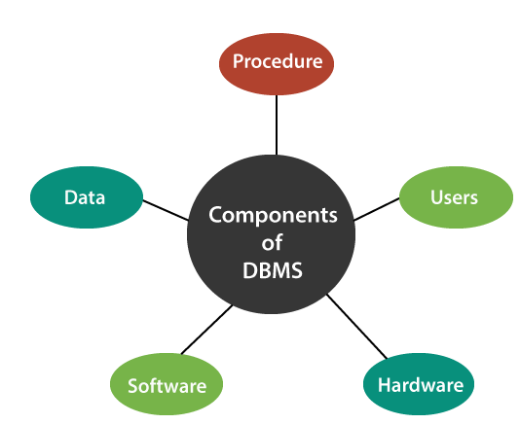
Components of DBMS

Slide 23
Components of DBMS
Software
The main component of a Database management system is the software. It is the set of programs which is used to manage the database and to control the overall computerized database.
The DBMS software provides an easy-to-use interface to store, retrieve, and update data in the database.
This software component is capable of understanding the Database Access Language and converts it into actual database commands to execute or run them on the database.

Slide 24
Components of DBMS
Hardware
This component of DBMS consists of a set of physical electronic devices such as computers, I/O channels, storage devices, etc that create an interface between computers and the users.
This DBMS component is used for keeping and storing the data in the database.

Slide 25
Components of DBMS
Procedures
Procedures refer to general rules and instructions that help to design the database and to use a database management system.
Procedures are used to setup and install a new database management system (DBMS), to login and logout of DBMS software, to manage DBMS or application programs, to take backup of the database, and to change the structure of the database, etc.

Slide 26
Components of DBMS
Data
It is the most important component of the database management system.
The main task of DBMS is to process the data. Here, databases are defined, constructed, and then data is stored, retrieved, and updated to and from the databases.
The database contains both the metadata (description about data or data about data) and the actual (or operational) data.

Slide 27
Components of DBMS
Users
The users are the people who control and manage the databases and perform different types of operations on the databases in the database management system.

Slide 28
Types of Database users
There are three types of user who play different roles in DBMS:
Application Programmers
Database Administrators
End-Users
Database Designers

Slide 29
Types of Database users
Application Programmers
The users who write the application programs in programming languages (such as Java, C++, or Visual Basic) to interact with databases are called Application Programmer.
Database Designers
Design the database
Database Administrators
A person who manages the overall DBMS is called a database administrator or simply DBA. Granting of authorization for data access, Routine maintenance etc
End-Users
The end-users are those who interact with the database management system to perform different operations by using the different database commands such as insert, update, retrieve, and delete on the data, etc.

Slide 30
Difference between DBMS and RDBMS
A DBMS is system software which is used to store and manage the data in the database. It was introduced in 1960 for storing the data or information. This system allows the user to manipulate the data such as insertion, updation, and deletion. It also maintains and creates the database.
The DBMS approach was developed to overcome the limitation of the file-based system. This system stores the data either in hierarchal or navigational form. Examples of DBMS are xml, file system, etc.

Slide 31
Difference between DBMS and RDBMS
RDBMS stands for Relational Database Management System. This DBMS follows the relational model in which the data is stored in multiple tables and tables are linked with each other using keys such as a foreign key. It supports the relational integrity constraints at the schema level.
The Relational Database Management System (RDBMS) is an advanced version of a Database Management System. It came into existence during the 1970s. This type of system also allows the organization to access data more efficiently than DBMS. RDBMS is a powerful DBMS and is widely used all over the world. The Standard Query Language (SQL) was used to access the data from the database.

Slide 32
Difference between DBMS and RDBMS
Normalization can be performed on the RDBMS. It helps to minimize the redundancy of data in RDBMS and easier to perform transactions.
It maintains ACID properties, which increases the integrity of the data. MS SQL Server, MySQL, and Oracle are some examples of RDBMS.

Slide 33
DBMS & RDBMS
DBMS | RDBMS
1. It stands for Database Management System. | 1. It extends for Relational Database Management System.
2. DBMS stores the data in the files. | 2. RDBMS stores the data in tables.
3. It can access only one data element at a time. | 3. It can access multiple data elements at a same time by using SQL queries.
4. It doesn’t support distributed database. | 4. It supports distributed database.
5. It fails to support the normalization technique. | 5. It supports normalization to eliminate or reduce redundancy.

Slide 34
DBMS & RDBMS Cont…
DBMS | RDBMS
6. This type of management system supports a single user only. | 6. This type of system supports multiple users.
7. It is system software used to manage databases on system hard disks and computer networks. | 7. It is mainly used to maintain relationships among tables.
8. It does not support client-server architecture. | 8. It supports client-server architecture.
9. This system stores the small quantity of data and used by small organizations. | 9. It is designed to handle the huge amount of data and used by large organizations.

Slide 35
DBMS & RDBMS Cont…
DBMS | RDBMS
10. No relationship exists between the tables. | 10. A relationship exists between tables using keys.
11. It takes more time while accessing the data. | 11. Data can be accessed faster than DBMS
12. It is difficult to modify the data. | 12. It is easier to change the data.
13. High redundancy of data in DBMS. | 13. Low redundancy of data in RDBMS.
14. Examples of DBMS are file system, Microsoft Access etc. | 14. Examples of RDBMS are MS SQL Server, MySQL, Oracle, etc.

Slide 36

DBMS Structure>> Query Processor
Program
Query Tool
Query processor
DDL interpreter: interprets DDL statements and records the
definitions in the data dictionary.
Query Processor
DML compiler: translates DML query statements into low-level instructions that the query evaluation engine understands.
Storage Manager
Database
Also performs query optimization i.e. it picks lowest cost
evaluation plan from a number of alternative evaluation plans.
Query evaluation engine: executes low-level instructions generated by the DML compiler.

Slide 37
DBMS Structure>> Storage Manager
Program
Query Tool
Storage manager
Authorization and integrity manager tests for the satisfaction of integrity constraints and checks the authority of users to access data.
Query Processor
Transaction manager ensures that the database remains in a consistent (correct) state despite system failures, and that concurrent transaction executions proceed without conflicting.
Storage Manager
Database
File manager manages the allocation of space on disk storage and the data structures used to represent information stored on disk.
Buffer manager is responsible for fetching data from disk storage into main memory, and deciding what data to cache in main memory.

Slide 38
DBMS Structure>> Database
Program
Query Tool
Database
Data files, which store the database itself.
Data dictionary, which stores metadata about the structure of
the database, in particular the schema of the database.
Query Processor
Storage Manager
Database
Indices, which provide fast access to data items that hold particular values.

Slide 39
Data Abstraction in DBMS
Database systems are made-up of complex data structures. To ease the user interaction with database, the developers hide internal irrelevant details from users. This process of hiding irrelevant details from user is called data abstraction.
We have three levels of abstraction:
Physical level
This is the lowest level of data abstraction. It describes how data is actually stored in database. You can get the complex data structure details at this level
Logical level
This is the middle level of 3-level data abstraction architecture. It describes what data is stored in database.
View level:
Highest level of data abstraction. This level describes the user interaction with database system.

Slide 40
Database Schemas
A schema can be defined as the design of a database. The overall description of the database is called the database schema. It can be categorized into three parts. These are:
Physical Schema/Internal Level Schema
The design of a database at physical level is called physical schema
Logical Schema/Conceptual Level Schema
The design of database at logical level is called logical schema, programmers and database administrators work at this level
View Schema/External Level Schema
The design of database at view level is called view schema. This generally describes end user interaction with database systems.

Slide 41
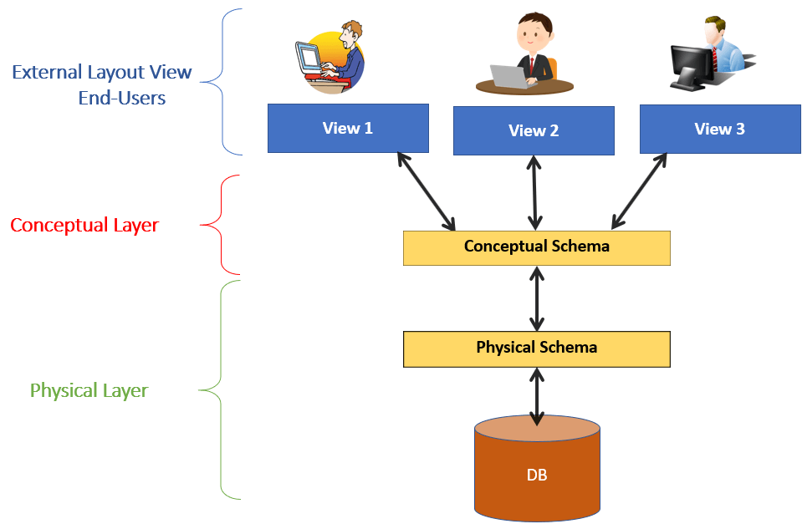
Database Schemas Layers Architecture

Slide 42
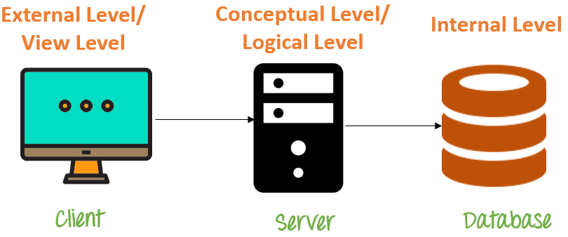
Database Schemas

Slide 43
Database Schemas: Example
Let suppose you are storing students' information on a student's table.
At the physical level, these records are described as chunks of storage (in bytes, Kilobytes, etc) in memory, and these elements often remain hidden from the programmers.
At logical level, these records can be illustrated as fields and attributes along with their data type(s); their relationship with each other can be logically implemented. Programmers generally work at this level because they are aware of such things about database systems.
At view level, a user can able to interact with the system, with the help of GUI, and enter the details on the screen. The users are not aware of the fact of how the data is stored and what data is stored; such features are hidden from them.

Slide 44


First Name: Rana Last Name: Aslam Date of Birth:
12 Sep, 1970
Name: R. Aslam Age: 24y,10d Dept: Sales
Saleema
Saleem
Name
DoB
Deps
DepId
Rana Aslam
12/09/70
5
0
D001
D005
Marya Wasti
29/02/80
BH
RH
Rana Aslam 120970 5 D001
RH
Marya Wasti…
01110011010011100101001010100101010010101…..

Slide 45
More about Database Schemas
External level Schema is the “top level” of the three Level DBMS Architecture.
It is also called view level. The reason this level is called “view” is because several users can view their desired data from this level which is internally fetched from database with the help of conceptual and internal level mapping.
The user doesn’t need to know the database schema details such as data structure, table definition etc. user is only concerned about data which is what returned back to the view level after it has been fetched from database.

Slide 46
More about Database Schemas
In logical/conceptual level schema, the whole design of the database such as entities, relationship among data, schema of data etc. are described in this level.
Database constraints and security are also implemented in this level of architecture. This level is maintained by DBA (database administrator)
This logical level comes between the user level and physical storage view. However, there is only single conceptual view of a single database.

Slide 47
More about Database Schemas
The internal/physical schema defines the physical storage structure of the database. The internal schema is a very low-level representation of the entire database
It helps you to keeps information about the actual representation of the entire database. Like the actual storage of the data on the disk in the form of records

Slide 48





Example: University Database
External Schema (View 1 ):
External Schema (View 2):
Course_info(cid:string,cname:string)
student_info(cid:string, name:string)
Students(sid: string
name: string, login: string, age: integer)
Courses(cid: string,
cname:string,
credits:integer)
Enrolled(Eid:string,
cid:string, grade:string)
Relations stored as unordered files.
Index on first column of Students.
Conceptual schema:
Physical schema:

Slide 49


Example: Employee database
External view 1 (C++)
DCL 1 EMPP,
2 EMP# CHAR(6)
2 SAL FIXEDBIN(31)
External view 2 (COBOL)
01 EMPC.
02 EMPNO PIC X(6).
02 DEPTNO PIC X(4).
Conceptual
EMPLOYEE
EMPLOYEE_NUMBER CHARACTER(6)
DEPARTMENT_NUMBER CHARACTER(6)
SALARY DECIMAL(5)
Internal STORED_EMP BYTES=20
PREFIX EMP# DEPT# PAY
BYTE=6 , OFFSET=0
BYTE=6, OFFSET=6, INDEX=EMPX BYTES=4, OFFSET=12
BYTES= 4, ALIGN= FULLWORD,OFFSET=16

Slide 50





Three Levels of Architecture
Syntax Example:
External view 1 External view 2
E_no | F_name | L_name | Age | Salary
Empl_No | L_name | B_no
Conceptual level
Empl_No | F_name | L_name | DOB | Salary | Branch_No
struct EMPLOYEE { int Empl_No;
int Branch_No;
char F_name [15];
char L_name [15];
struct date Date_of_Birth; float Salary;
struct EMPLOYEE *next;
Internal level
//pointer to next employee record
}; index Empl_No; index Branch_No; //define indexes for employees

Slide 51
Advantages Database Schema
You can manage data independent of the physical storage
Faster Migration to new graphical environments
DBMS Architecture allows you to make changes on the presentation level without affecting the other two layers
As each tier is separate, it is possible to use different sets of developers
It is more secure as the client doesn't have direct access to the database business logic
In case of the failure of the one-tier no data loss as you are always secure by accessing the other tier

Slide 52
Disadvantages Database Schema
Complete DB Schema is a complex structure which is difficult to understand for every one
Difficult to set up and maintain
The physical separation of the tiers can affect the performance of the Database

Slide 53
Three Level Architecture Objectives
Each user should be able to access the same data but have a different customize view of the data.
User should not have to deal directly with physical database storage detail.
The DBA should be able to change the database storage structure without affecting the users views.

Slide 54
Three Level Architecture Objectives
The internal structure of the database should be unaffected by changes to the physical aspects of storage.
The DBA should be able to change the conceptual structure of the database without affecting all users.

Slide 55
Data Independence
Data independence is the capacity to change the schema at one level without having to change the schema at the next higher level
There are two kinds:
Logical data independence
Physical data independence

Slide 56
Data Independence
Logical data independence
The ability to modify the conceptual scheme without causing application programs to be rewritten.
The change would be absorbed by the mapping between the external and conceptual levels.
Examples
Adding a new file/index etc.
Adding a new field in a file
Changing type/size
Deleting an attribute

Slide 57
Data Independence
Physical data independence
The ability to modify the internal scheme without having to change the conceptual or external schemas.
Modifications at this level are usually to improve performance.
Example
Changing file organization
Index implementation, hash, tree etc.
Changing storage medium

Slide 58
Thanks

